Slide 1
Introduction to Animal Science
By: Mrs. Sheffield

Slide 2
Objectives:
Define science.
Discuss scientific inquiry.
Explain scientific decision making .
Compare hypotheses to scientific theories.
Identify important scientific advances related to animal science and agriculture.

Slide 3
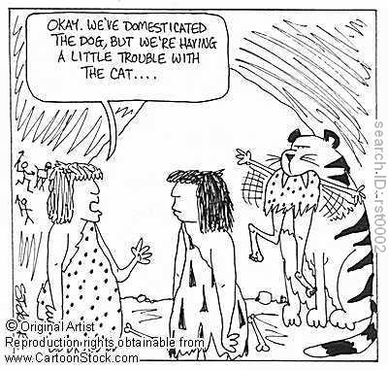
Objectives:
Explain the domestication of animals
Discuss the history of production agriculture

Slide 4
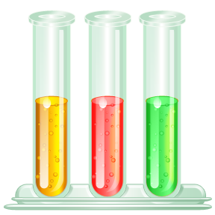
Definition of Science
According to the National Academy of Sciences, science is:
“the use of evidence to construct testable explanations and predictions of natural phenomena, as well as knowledge generated through this process.”

Slide 5

Goal of Science
To provide explanations for things that happen
A way of thinking, observing, and knowing about the world

Slide 6
Limitations of Science
Role of science (and technology) has a strong presence in our daily living
Advances may improve our lives, but also raise ethical, legal, and social questions
  Example: Cloning
  Science has limitations

Slide 7
Basic Tenets or Assumptions of Science
The universe is physical
  Events experienced with sight, sound, smell, taste, and/or touch
The universe is understandable
  Laws of nature are reasonable and can be understood by humans
The universe is causal
  All events have natural causes which also produces a natural effect
The universe is random yet rational
  Science is orderly in pattern and structure, events of the universe are predictable

Slide 8
Scientific Questions
Some scientific questions are outside the realm of science because they deal with phenomena that are not scientifically testable.
Can you think of any?

Slide 9
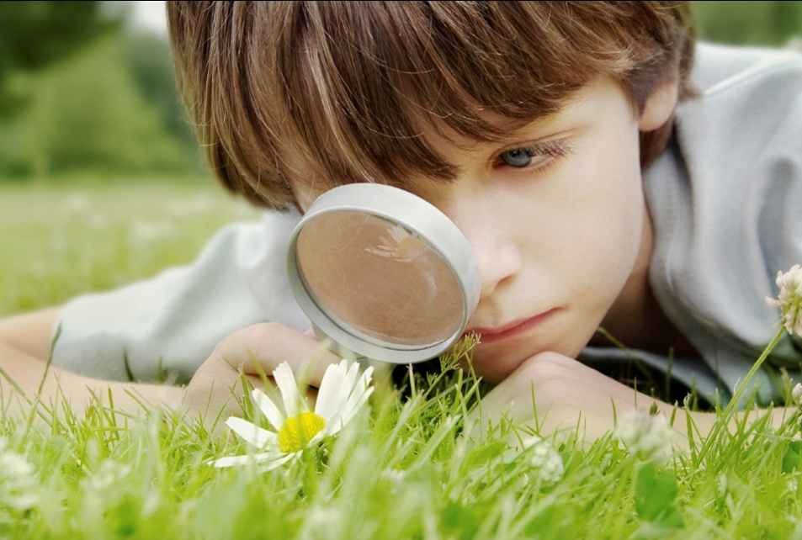
Scientific Inquiry
Definition: the planned and deliberate investigation of the natural world.
Scientific methods of investigation are:
  Experimental
  Descriptive
  Comparative
The method above
should match the
question being asked.

Slide 10
Experimental Investigations
Involve designing a fair test, similar to a comparative investigation, but a control is identified
  Fair test: only one factor (variable) is changed at a time, while keeping all other conditions the same
Variables measured in an effort to gather evidence to support or not support a causal relationship

Slide 11
Descriptive Investigations
Collect qualitative and/or quantitative data to draw conclusions about a natural or man-made system
  Example: rock formation, animal behavior
Includes a question, but no hypothesis
Observations are recorded, but no comparisons are made and no variables are manipulated

Slide 12
Comparative Investigations
Make a comparison
Collect data on different organisms/objects/ features/events or under different conditions (time of year, air temperature, location)
Hypothesis identifies one independent (manipulated) variable and one dependent (responding) variable
Fair test can be designed to measure variables so that the relationship between them is determined

Slide 13
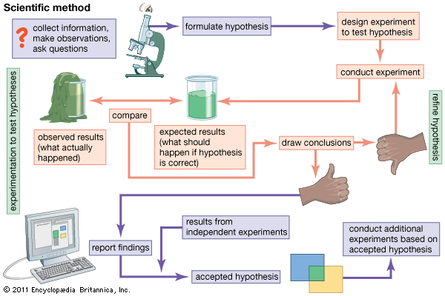
Scientific Inquiry is a Non-linear Process

Slide 14
Science and Social Ethics
Scientific decision making:
  way of answering questions about the natural world.
Ethical and social decisions that involve science
  Application of scientific information

Slide 15
Science, Systems, and Models
System: collection of cycles, structures, and processes that interact
Described in space, time, energy, and matter
Change and constancy occur
  Patterns can be observed, measured, and modeled
Patterns help make predictions that can be scientifically tested

Slide 16
Hypotheses
Tentative and testable statements that must be capable of being supported or not supported by observational evidence.
Theories: hypotheses that have been tested over a wide variety of conditions

Slide 17
Scientific Theories
Based on natural and physical phenomena
Can be tested by multiple independent researchers
Well-established, highly-reliable explanations (unlike hypotheses)
May be subject to change
  Development of new areas of science and technologies

Slide 18

Data
Quantitative:
Can be measured
Length, height, area, volume, weight, speed, time, temperature, humidity, sound levels, cost, members, ages, etc.
Qualitative:
Can be observed but not measured
Colors, textures, smells, tastes, appearance, beauty, etc.

Slide 19
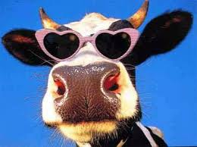
So, why all this science stuff?
This is animal science!!
This is a science course that focuses on animals, specifically, livestock species.

Slide 20
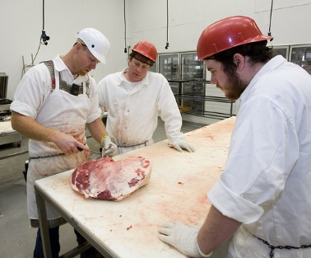
Animal Science
Important to U.S. economy
Applied to:
  Breeding
  Production
  Nutrition
  Animal agribusiness
  Behavior
  Well being
  Biotechnology

Slide 21
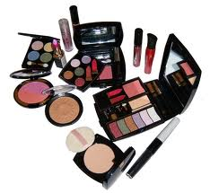
How do animals affect us?
Food & clothing
Companionship
Labor
Medical research
Animal by-products:
Ingredients in consumer products from insecticides and cosmetics

Slide 22
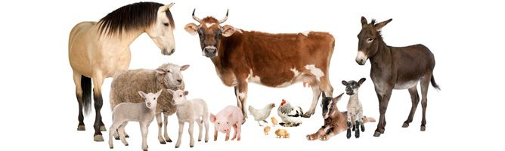
Where Did it All Begin?
Domesticate: to adapt the behavior of an animal to fit the needs of people
Early humans began to confine and breed animals to ensure steadier supply of food and clothing
  Later select & breed animals with desirable characteristics (selective breeding)

Slide 23
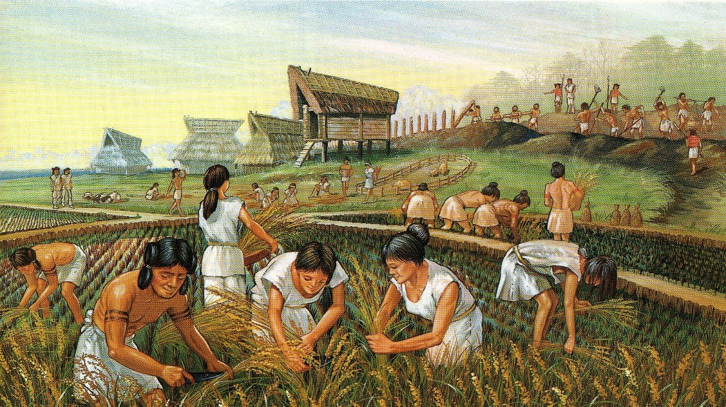
Domestication of Animals
Switch from hunter-gather to more settled way of life
  Leads to increase in population
Some historians believe the human race would never have become civilized without domestication of animals

Slide 24
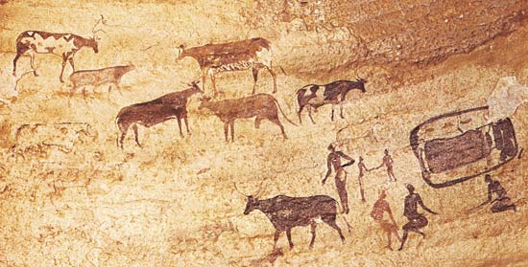
Domestication of Cattle
Modern are descendants of:
  Bos taurus
  Bos indicus

Slide 25
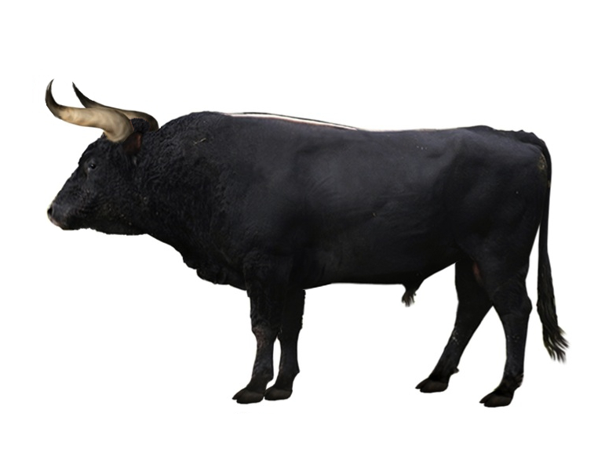
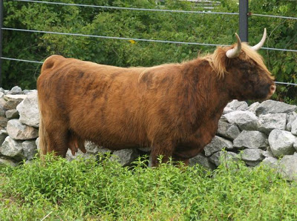
Bos Taurus
Came from either Aurochs or Celtic Shorthorns

Slide 26
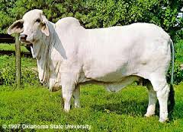
Bos Indicus
Humped cattle originating in the tropical countries
Common in modern cattle production in the U.S.
Resistant to some diseases, parasites, and heat than Bos taurus

Slide 27
Domestication of Cattle
New Stone Age – 18,000 years ago
Used for pulling loads, meat, milk
Crossbreeding: the mating of animals of different breeds
  Resulted in improved animals and different breeds
Not native to the U.S.
  Brought cattle to New World on second voyage by Christopher Columbus in 1493
  Portugese traders brought more in 1553
  English brought large numbers in 1611 with foundation of Jamestown colony
  Spanish longhorn cattle arrive in Mexico in 1521

Slide 28
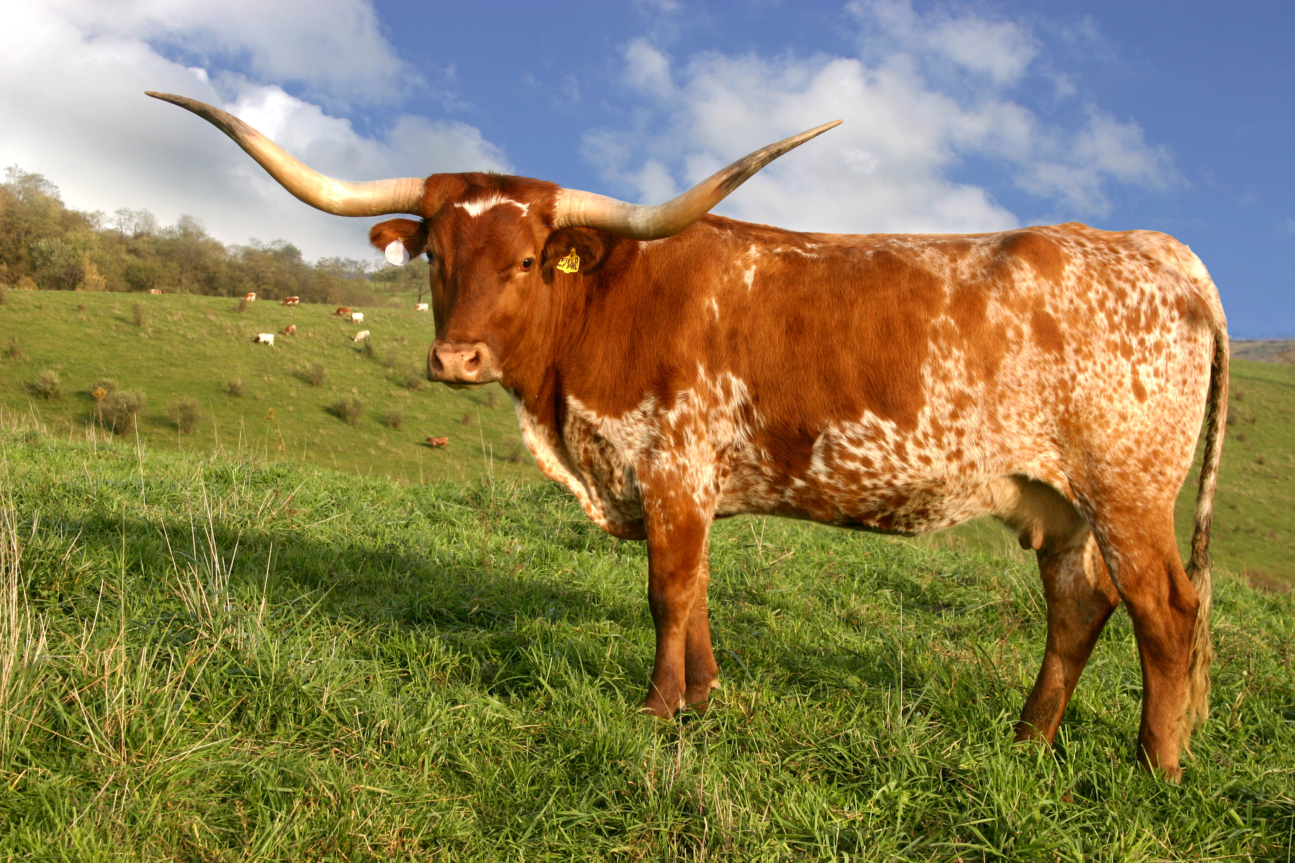
Texas Longhorn

Slide 29
Domestication of Cattle
Major growth of herds happens in Great Plains states
  Vast grazing land
Before 1850s, most farms had 2+ dairy cows that provided milk and butter
Late 1800’s – dairy herds increase as demand from growing cities increases
  Peaked in mid-1940’s, decreasing steadily since

Slide 30
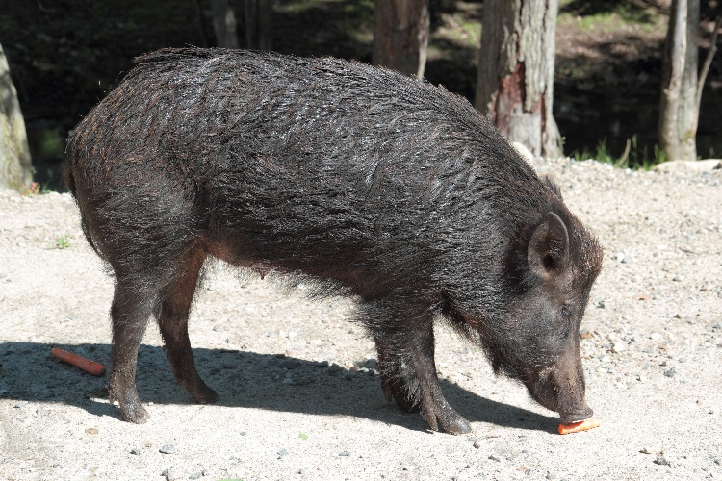
Domestication of Swine
5th per. 8/20
American breeds come from:
  European wild boar (sus scrofa)
  East Indian pig (Sus vittatus)
Some wild types of piglike animals which have never been tamed exist in some parts of the world
First use for food in Neolithic Age
First to tame were Chinese – about 4900 B.C.
Biblical references – 1500 B.C.
Keeping of Swine in Great Britain – 800 B.C.

Slide 31
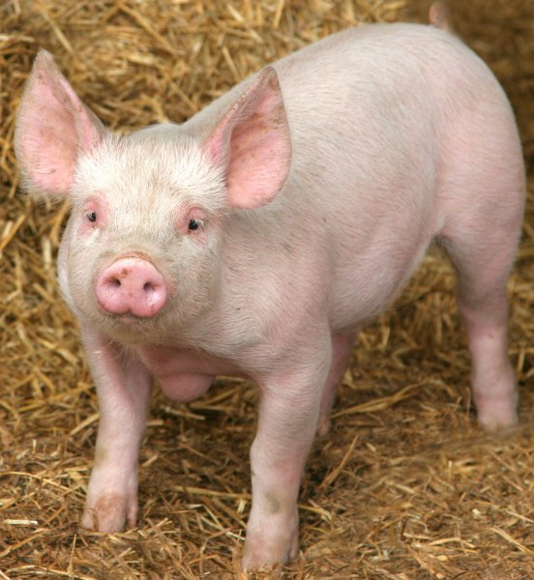
Domestication of Swine
Brought by Columbus on second voyage in 1493
More brought later by Spanish explorers
First major increase – 1539
  Spanish explorer DeSoto brought 13 head to Florida
English settlers also brought
Supply became greater than demand
  Export pork and lard
Main expansion in Corn Belt States

Slide 32
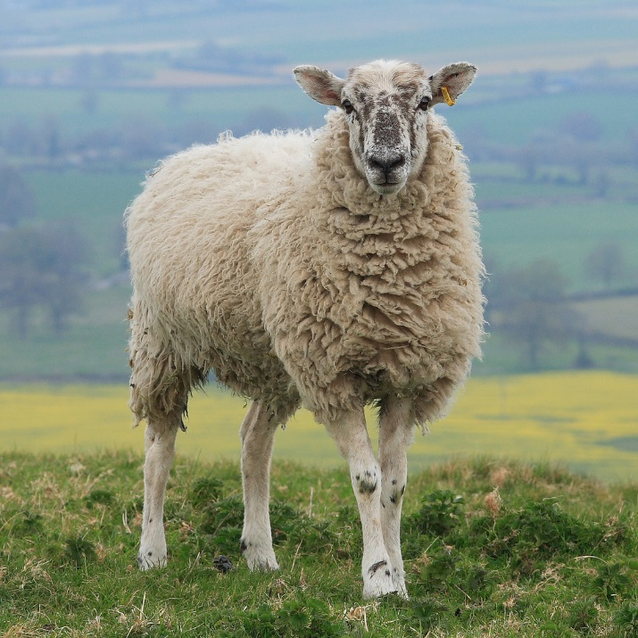
Domestication of Sheep
Among first animals tamed by human race
  Early Neolithic Age
Shown on early Egyptian sculpture – 4000 B.C.
Mentioned in earlier passages of the Bible
Sheep bones found in caves & lake dwellings used by early Europeans
Wool fabrics found in ruins of
Swiss Lake villages
  10,000-20,000 years ago

Slide 33
Domestication of Sheep
By 1500 A.D. Spain & England major sheep-producing areas
Ancestry not as well known
All breeds timid, defenseless, and least intelligent of tamed animals
Most present-day probably come from:
  Mouflons
  Asiatic urial
Wild, big-horned sheep of Asia ancestors of present-day breeds

Slide 34
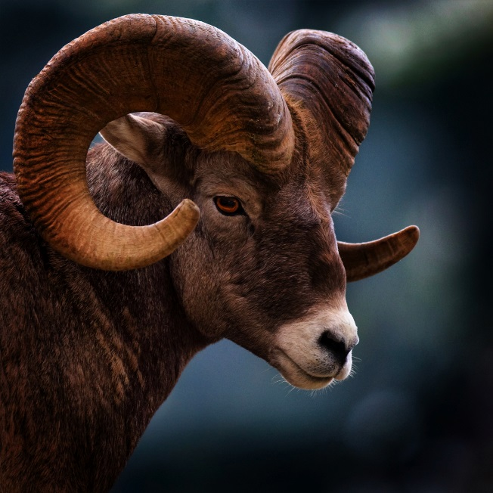
Domestication of Sheep
Only native to North America:
  Big Horn / Rocky Mountain Sheep
Columbus brought in 1493
Merino sheep brought by Cortez to Mexico in 1519
British sheep imported to Virginia in 1609
Mainly used for wool production
By 1840 – 19 million head in U.S.

Slide 35
Domestication of Goats
First tamed in Neolithic Age
  First tamed animals in Western Asia
Descended from Pasang or Grecian Ibex
  Species of wild goats found in Asia Minor, Persia, & other countries
Markhors and Tahrs may be ancestors of some of today’s domestic breeds
Closely related to sheep

Slide 36
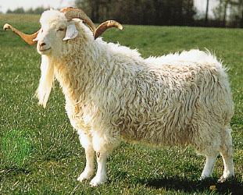
Domestication of Goats
Remains found in Swiss Lake villages of Neolithic Age
Bible refers to use of mohair
Early goat importations to U.S. from Switzerland
Angora flocks came from Turkey
  Mohair production increased
  in 20th century
  Texas has largest number of
  Angoras in country

Slide 37
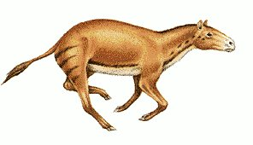
Domestication of Horses
4th per. 8/19
Evolved from 4-toed Eohippus (dawn horse)
  1 foot high
  Lived in swamps 58 million years ago
  Gradually grew in size
  Changes in feet and skeleton
  Native to North American continent
  Disappeared before Europeans arrived

Slide 38
Domestication of Horses
First domestication – Central Asia or Persia before 3000 B.C.
Babylonians – 2000 B.C.
Egyptians – 1600 B.C.
Used by ancient Greeks & Romans
Arabs did not use until after 600 A.D.
Columbus brought to New World in 1493
Cortez imports to Mexico in 1519
First importation to present U.S. was by DeSoto in 1539

Slide 39
Domestication of Horses in the United States
Saddle & draft horse brought by early colonists
  Served mainly as pack animals & for riding
Heavier drafts brought by Dutch, Puritan, & Quakers
  Used for work
Early development primarily associated with riding on plantations
Horse racing developed in 1700s and early 1800s

Slide 40
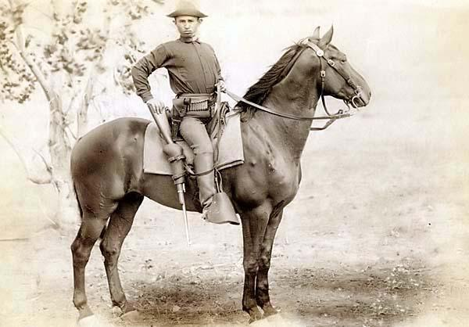
Domestication of Horses
With development of other sources of power, drafts on farms declined
Rapid decline after WWI
  Military cavalry horses were left in Europe
Most in U.S. used for riding & racing

Slide 41
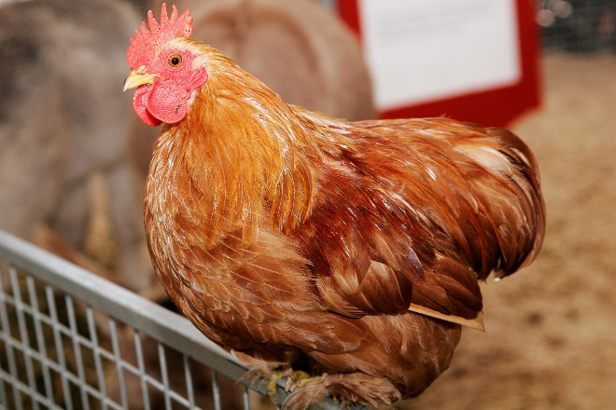
Domestication of Poultry
Domesticated in India and raised by Chinese and Egyptians about 1400 B.C.
Drawings of chickens found in Egyptian tombs from that time
Used early for food, but only recently has become a major commercial enterprise?
  Why do you think that is?
  Turn to your neighbor and discuss.

Slide 42
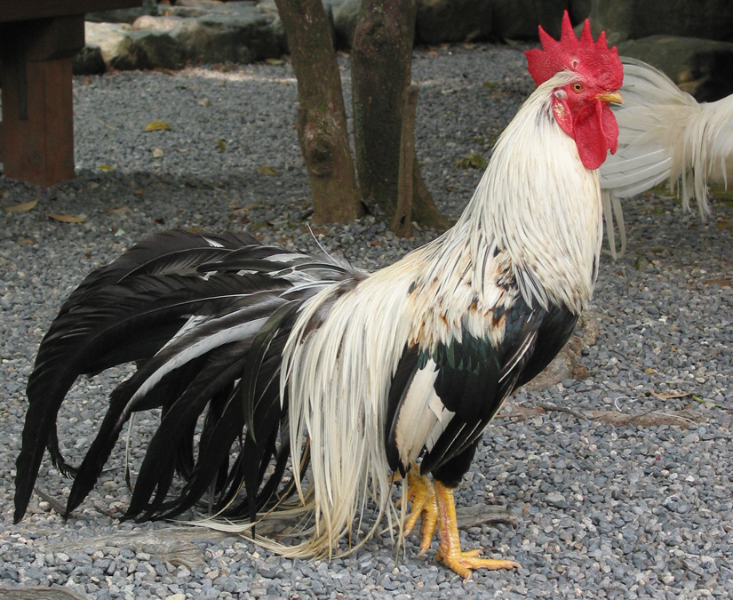
Domestication of Poultry
Gallus gallus- wild jungle fowl of India
  May be early ancestor of most tame chickens
Turkeys descended from two wild species
  One in Mexico
  One in U.S.
  Probably tamed by people originally living in America

Slide 43
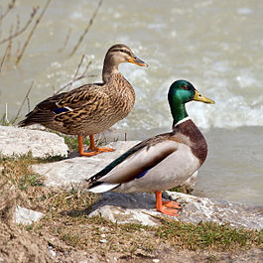
Domestication of Poultry
Anas boschas- wild mallard duck
  Thought to be ancestor of all domestic breeds of ducks
  China has raised ducks on a commercial basis longer than other parts of the world
Goose- tamed shortly after the chicken
  Sacred bird in Egypt
  4,000 years ago

Slide 44
Domestication of Poultry
Brought to New World by explorers & colonists
1850: Poultry shows lead to development of recognized breeds
American poultry industry grew out of small home flocks raised by early settlers
Demand increased as population grew
  More specialized in 1800s
  Highly specialized today
  Concentrated in the South

Slide 45
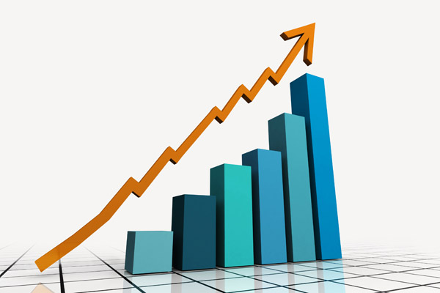
Trends in Animal Agriculture
Changes in lifestyle & eating habits has significant impact
Concern over cholesterol levels
Consumers demanding leaner meat and less fat in meat and dairy products
Competitive marketplace drives increased efficiency in production to lower per unit cost to consumers

Slide 46
Trends in Animal Agriculture
Swine industry moved rapidly toward large, integrated production systems, like broilers
  Number of operations decreasing, size of operations going up
Large feedlot operations prominent in beef production
  Use of grain for finishing cattle expected to decline moderately due to use of roughages and other crop by-products

Slide 47
Trends in Animal Agriculture
Dairy farms decreasing, size increasing
  Total number of cows decreasing
  Increase in production per cow due to use of growth hormone rBST
Increase in per capita consumption of poultry, especially broilers, expected to continue
Sheep numbers sharply down since 1945
  Leading grocery chains promoting American lamb
  Nontraditional markets (on-farm sales, farmer markets, small processors serving ethnic communities) grown rapidly

Slide 48
Trends in Animal Agriculture
Wool & lamb prices generally increased
Goat industry growing
  Worldwide, people eat more goat meat and dairy products than any other animal
  Healthy, low-fat meat and high-calorie milk for people in globe’s harshest climates
  Similarly sized serving has 1/3 fewer calories than beef and ¼ fewer than chicken, much less fat

Slide 49
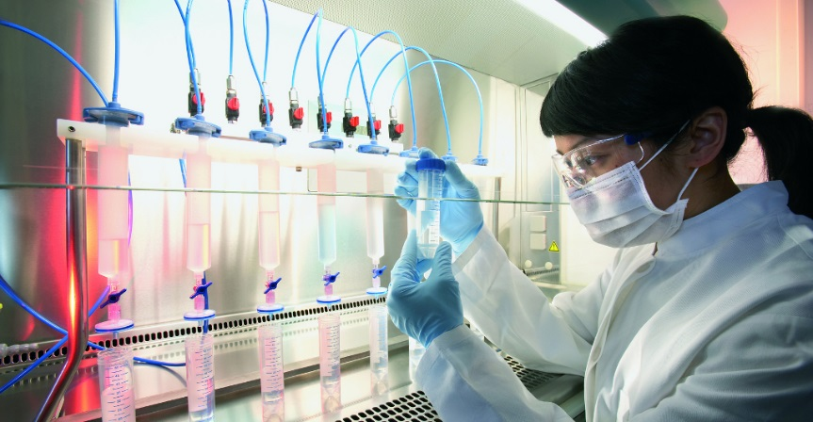
Areas of Research Impacting Livestock Industry
Higher embryonic survival rate in swine
Shortening of calving interval for dairy cattle
Improved methods of artificial insemination
Biotechnology
What do you think about the research being done in these areas? Share your opinion with your neighbor.

Slide 50
Biotechnology
Definition: the use of biology or biological processes to develop helpful products and services.
Leading to new products benefiting agriculture, human health, and the environment
Research in genetics and production improving efficiency
  Areas: cloning, superovulation, sex determination, in-vitro fertilization, embryo transfer

Slide 51

Topic Review:
Share with your neighbor what you thought was the most interesting thing you learned from this lesson.

